Slide 1

DHES
DOMOTIC
HOUSE FOCUSED ON
ENERGY
SAVING
Leonardo Pedretti & Giulia Casarini
IOT’s Course

Slide 2
INDEX
THE IDEA BEHIND DHES
HARDWARE SIDE
SOFTWARE DEVELOPMENT

Slide 3

OUR IDEA:
EVERYDAY LIFE
FOR EVERYONE
IN ITALY
2 MAIN EVERYDAY PROBLEMS

Slide 4

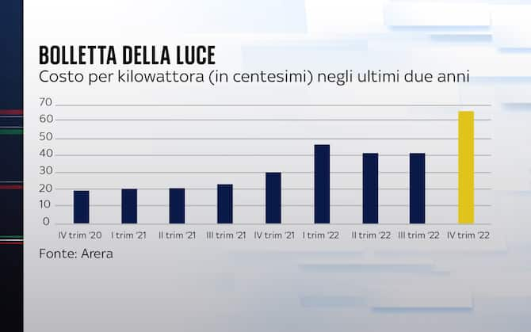
1°: MONEY

Slide 5


2° : ENVIRONMENT

Slide 6




WHICH ARE OUR GOALS :
ADVANTAGES

Slide 7

DHES MEANS :
DEFER ENERGY thanks to
Temperature Control
Motion Control
Weather Forecast Informations
Light Control

Slide 8
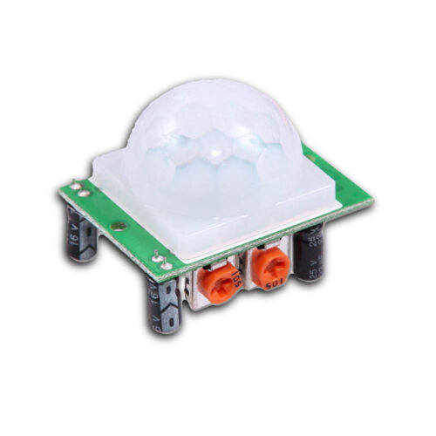



OUR MAIN SENSORS :
Infrared Monitor Sensor Temperature & Humidity Sensor
Photoresistor
Infrared Receiver

Slide 9

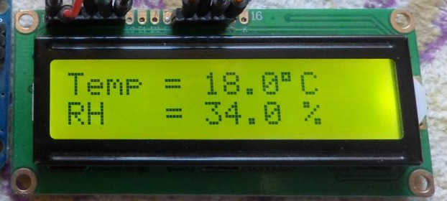


OTHER COMPONENTS :
Servo Sweep
Leds
LCD
Remote Controller

Slide 10

IN WHICH WAY are TEMPERATURE, PRESENCE, LIGHTS and WINDOWS CONTROLLED ?
automatically by the appropriate sensors
by remote controller
by TELEGRAM application
Web Interface

Slide 11
1) automatically by the appropriate SENSORS:
if the movement sensor does not detect a presence
if the temperature sensor detects a too high or too low temperature
our system will divide the energy to be used according to a priority due to several factors

Slide 12
2) by REMOTE CONTROLLER:
+ & - to raise/lower temperature
Switch ON/OFF to on/off the lights
Botton ‘0’ to Open/Close the windows

Slide 13
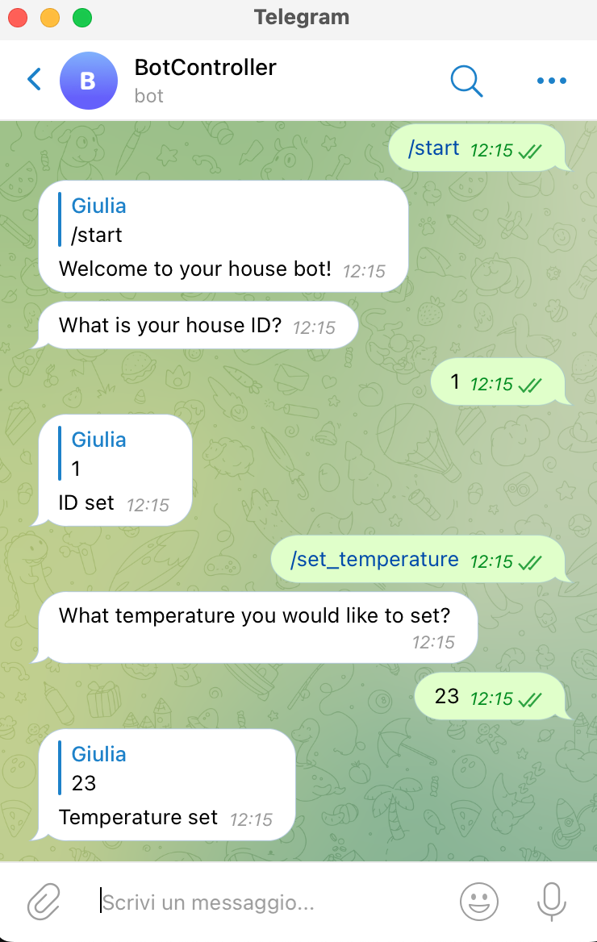

3) by Telegram Application with BOT CONTROLLER

Slide 14
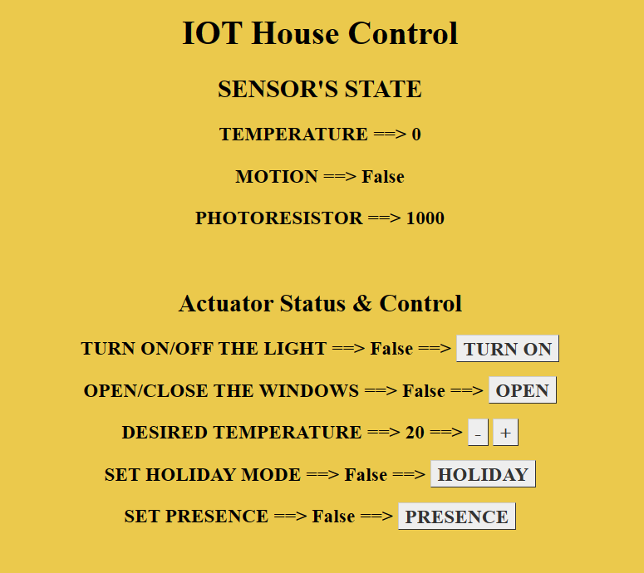

4) WEB INTERFACE

Slide 15
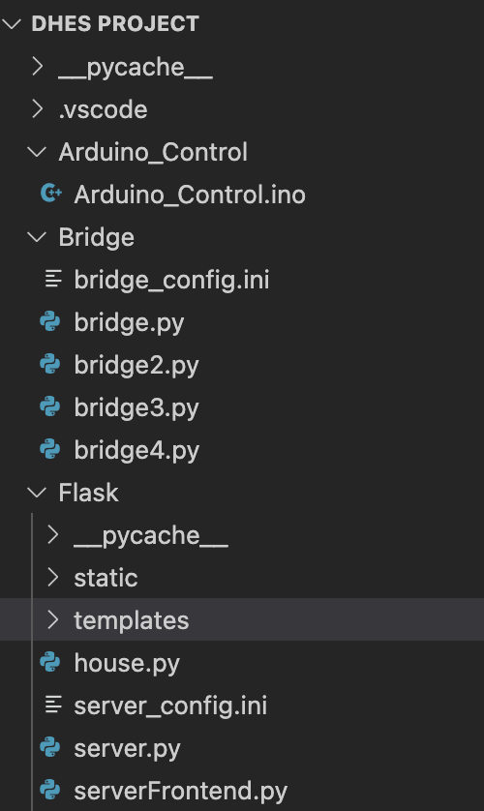
ORGANIZATION OF THE PROJECT
14

Slide 16







THANKS TO:

Slide 17


PRIORITY
DEF ASSIGN_SLOTS(SELF) :
toc = time.perf_counter()
slot_elapsedtime = int(toc - self.slot_timer)
if(houses_list[current_slot].presenza == True
and slot_elapsedtime < 180):
if (houses_list[current_slot].accensione == False):
Slot di energia assegnato alla casa houses_list[current_slot].id
houses_list[current_slot].accensione = True
else:
houses_list[self.current_slot].accensione = False

Slide 18

EVERYDAY LIFE
G
R
A
P
H
I
C
A
L
L
Y
DAY
WINTER
NIGHT
DATATIME
SUMMER
DAY = NIGHT
HOLIDAY
Motion sensor

Slide 19

More specifically….
1. MODE: EVERYDAY LIFE
if (house.holiday == False):
1.1 WINTER
if(datetime.now().month < 5 or datetime.now().month > 9):
1.1.1 DAY
if (datetime.now() < start_night or datetime.now() > start_day):
1.1.2 TURN ON THE BOILER
if(temperature <des_temperature and boiler == False
and power_permission == True):
self.publish_commands(house.id, 1, 1)
boiler = True
1.1.3 TURN OFF THE BOILER
elif((temperature >= des_temperature and boiler == True)
or (power_permission == False and boiler == True)):
self.publish_commands(house.id, 1, 0)
boiler = False
1.1.2 NIGHT
else:
1.2.1 TURN OFF THE BOILER
self.publish_commands(house.id, 1, 0)
boiler = False

Slide 20
More specifically….
1.2 SUMMER
1.2.1 TURN ON THE AIR CONDITIONER
elif(temperature >= des_temperature
and air_conditioner == False
and power_permission == True ):
self.publish_commands(current_house.id, 4, 1)
current_house.air_conditioner = True
1.2.2 TURN OFF THE AIR CONDITIONER
elif((temperature <des_temperature
and air_conditioner == True)
or (air_conditioner == True
and power_permission == False)):
self.publish_commands(house.id, 4, 0)
else:
2. MODE: HOLIDAY
if (sensor == 1):
if (val == 1):
house.holiday = False

